Slide 1
Procedural Level Generation with Diffusion Models from a Single Example
Shiqi Dai, Xuanyu Zhu, Naiqi Li, Tao Dai, Zhi Wang*

Slide 2
Outline
1
Motivation
2
Contribution
3
Proposed Approach
4
Experiments

Slide 3
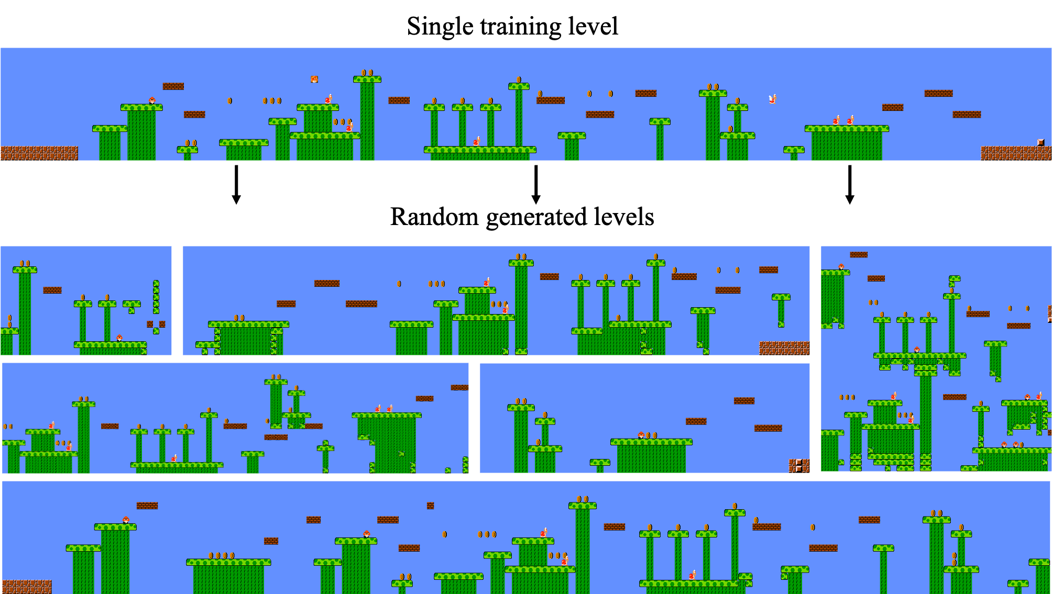
Motivation
Demand for Learning from a Single Example
Increasing demand for 3D Game content
Scarce training data
+
Kitti, coco,celeba…
Super Mario Bros, Minecraft…
GB level
v.s
MB level
Training a generative model to learn from a single example

Slide 4
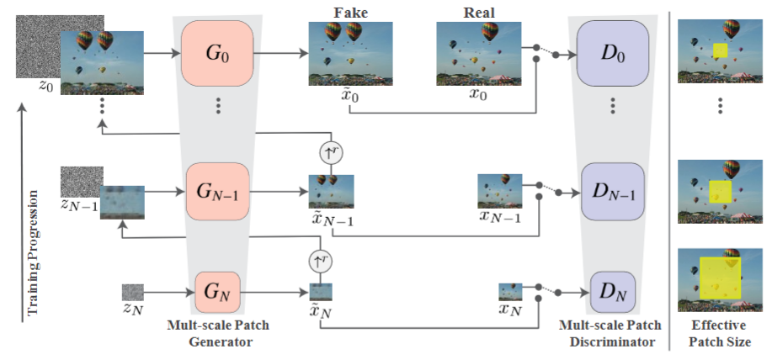
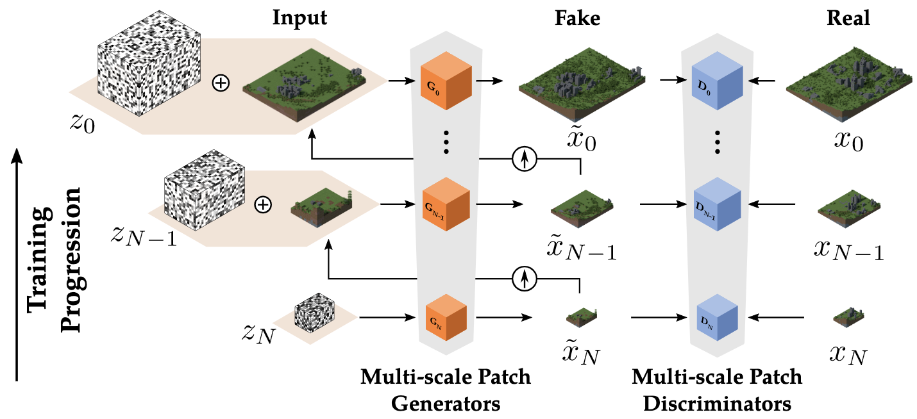
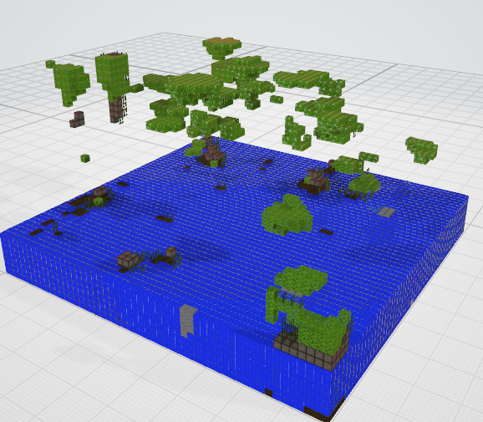
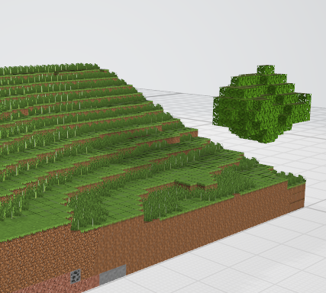
Motivation
Current GAN-based Approach
Pyramid-shaped groups of GANs with multi-scale
SinGAN
WorldGAN
Drawbacks: 1) Multi-stage generation tends to accumulate errors.
2) Vast latent space, which requires search algorithms to select“good”levels.
incorrect or incomplete structures
. . .
[1] Shaham, T.R, et al. "Singan: Learning a generative model from a single natural image." Proceedings of the IEEE/CVF International Conference on Computer Vision (ICCV).2019.
[2] M. Awiszus, et al. "World-GAN: a Generative Model for Minecraft Worlds." IEEE Conference on Games (CoG). 2021.

Slide 5
Outline
1
Motivation
2
Contribution
3
Proposed Approach
4
Experiments

Slide 6
Contribution
We propose a diffusion model trained on a single token-based level. Two keys to limit the receptive fields of our diffusion model are: fully convolutional networks with residual connections and training using large crops, aiming to capture the internal distribution of the game level.
We draw a connection between level generation using semantic tokens and text generation within the embedding space. It is proved that dense token representation and training loss inspired by text generation improve the percentage of available generated results.
Experimental results show that our model outperforms the baseline approaches and achieves excellent results in terms of diversity and quality for the generated levels.

Slide 7
Outline
1
Motivation
2
Contribution
3
Proposed Approach
4
Experiments

Slide 8
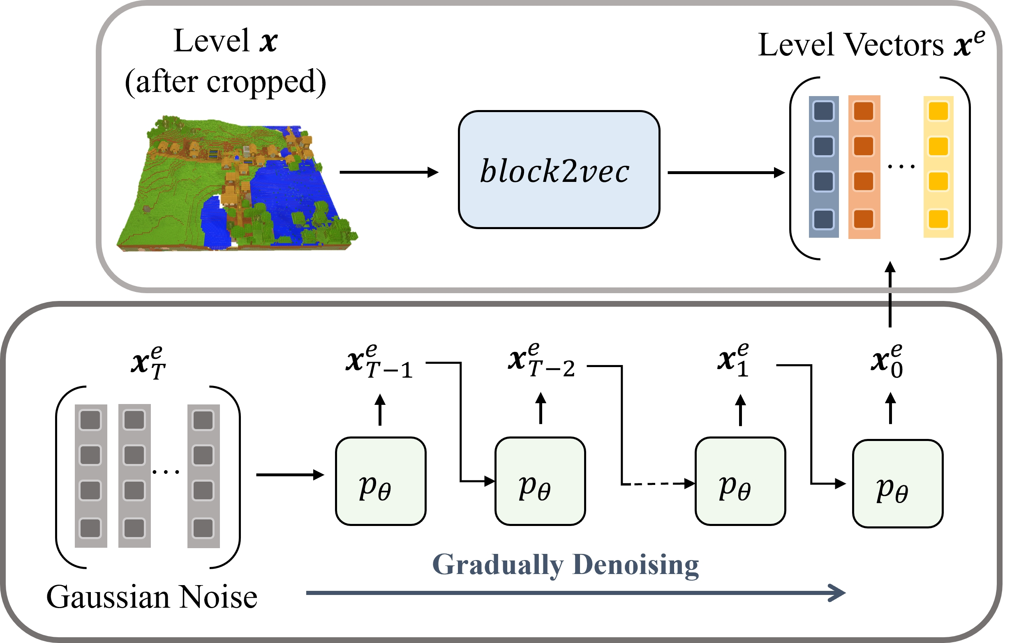
Proposed Approach
Overview
Given a piece of game level as input $x$ , we initially train $block2vec$ token embeddings to map the cropped level to an implicit latent representation, denoted as $x^{e}$.
Then we train a denoising network $p_{θ}$ on it to learn the distribution of latent features.
At inference time, we sample a new latent feature using the diffusion model and then map the resulting embeddings to the nearest tokens.

Slide 9
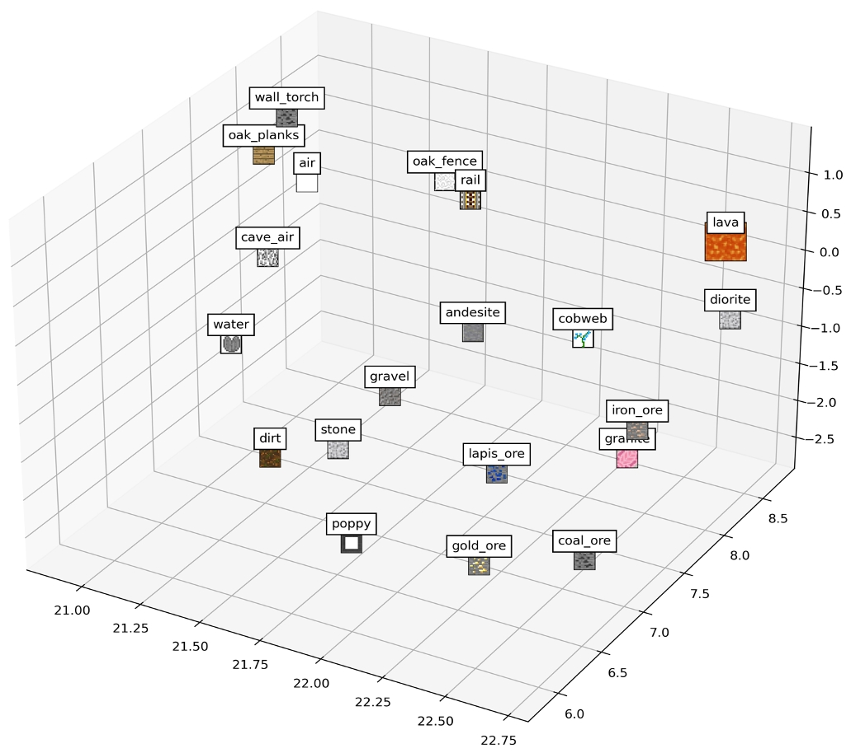
Proposed Approach
Level Representation
For a level $L$ composed of token $t$ :
A two-layer skip-gram model is enough for a level with no more than 70 types tokens.
Embeddings learned by block2vec of the vanilla mineshaft structure using UMAP.

Slide 10
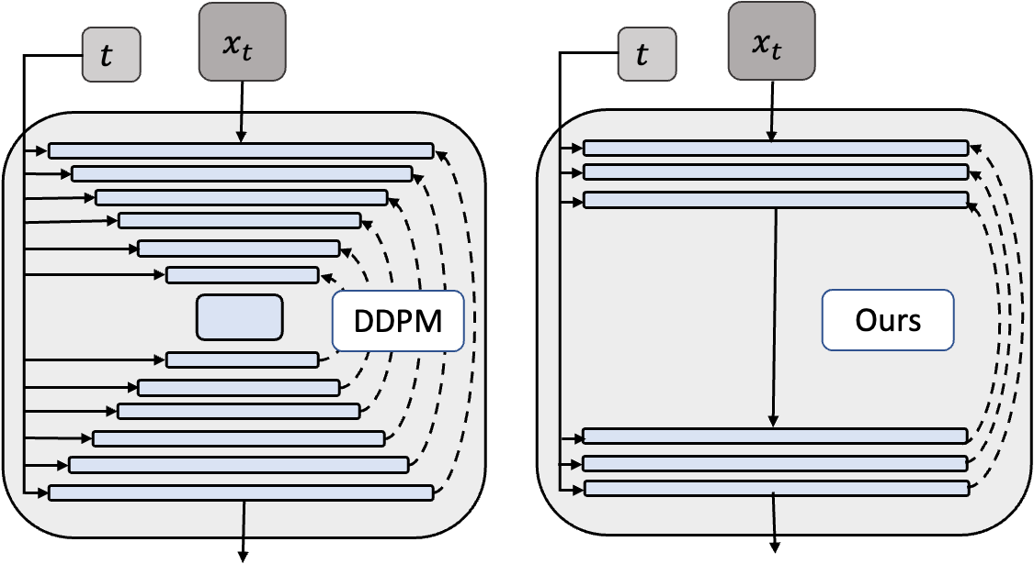
Proposed Approach
Network Architecture
Removed all upsampling, downsampling and intermediate attention layers.
Confine the network’s receptive field.

Slide 11
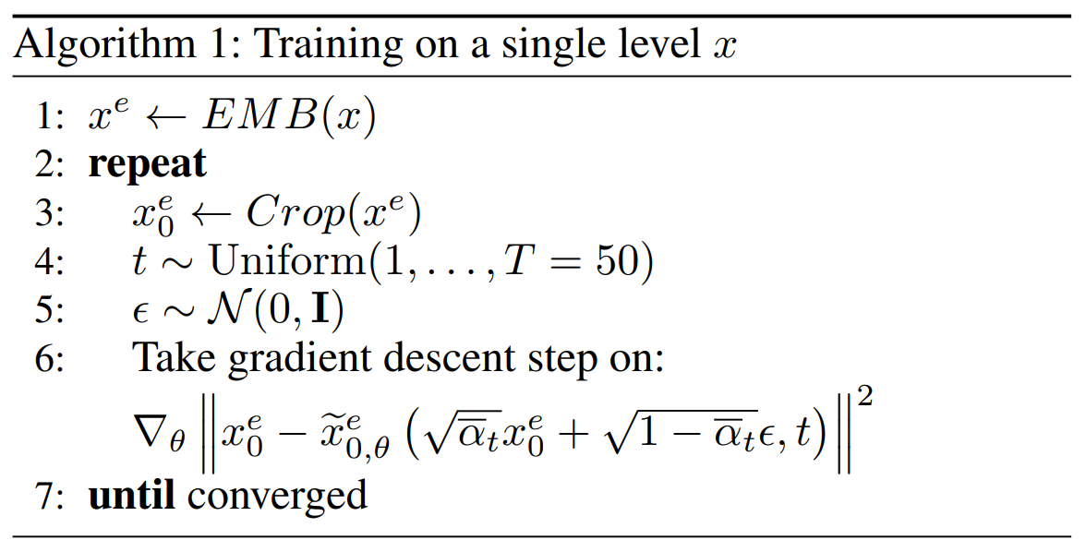
Proposed Approach
Training Procedure
Large Random Crops
①
②
Predict $x_{0}^{e}$

Slide 12
Outline
1
Motivation
2
Contribution
3
Proposed Approach
4
Experiments

Slide 13
Experiments
Setup
Datasets
Minecraft: DREHMAL:PRIMΩRDIAL
Super Mario Bros: VGLC
Baselines
Minecraft: World-GAN、TOAD-GAN 3D
Super Mario Bros: TOAD-GAN
[1] https://www.planetminecraft.com/project/drehmal-v2-prim-rdial-12k-x-12k-survival-adventure-map/
[2] Summerville, A. J, et al. “The VGLC: The Video Game Level Corpus.” Proceedings of the 7th Workshop on Procedural Content Generation.2016.
[3] M. Awiszus, et al. "World-GAN: a Generative Model for Minecraft Worlds." IEEE Conference on Games (CoG). 2021.
[4] Awiszus, Maren, et al. "TOAD-GAN: Coherent Style Level Generation from a Single Example." Proceedings of the AAAI Conference on Artificial Intelligence and Interactive Digital Entertainment (AIIDE). 2020.

Slide 14
Experiments
Setup
Evaluation Metrics
Tile Pattern KL-Divergence
visual quality
Levenshtein Distance
level diversity
A* agent
level playability
Human Preference Scores
human aesthetics
[1] Lucas, S. M., et al. “Tile pattern kl-divergence for analysing and evolving game levels.” In Proceedings of the Genetic and Evolutionary Computation Conference. 2019.
[2] Hao, Zekun, et al. "GANCraft: Unsupervised 3D Neural Rendering of Minecraft Worlds." Proceedings of the IEEE/CVF International Conference on Computer Vision. 2021.

Slide 15
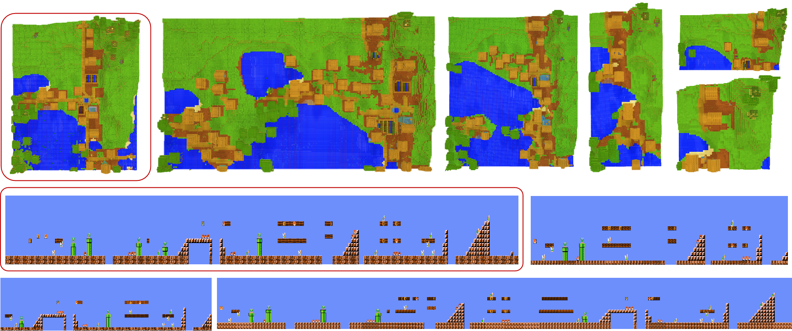
Experiments
Qualitative Results

Slide 16
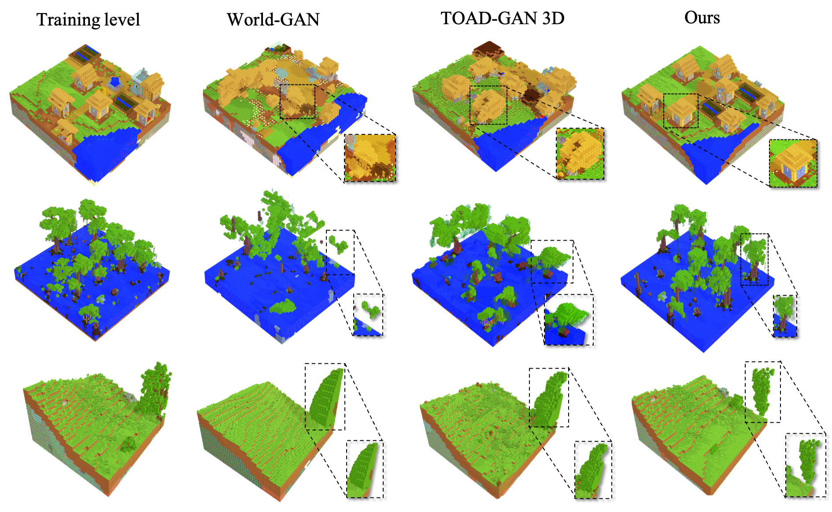
Experiments
Comparison with baselines - Minecraft

Slide 17
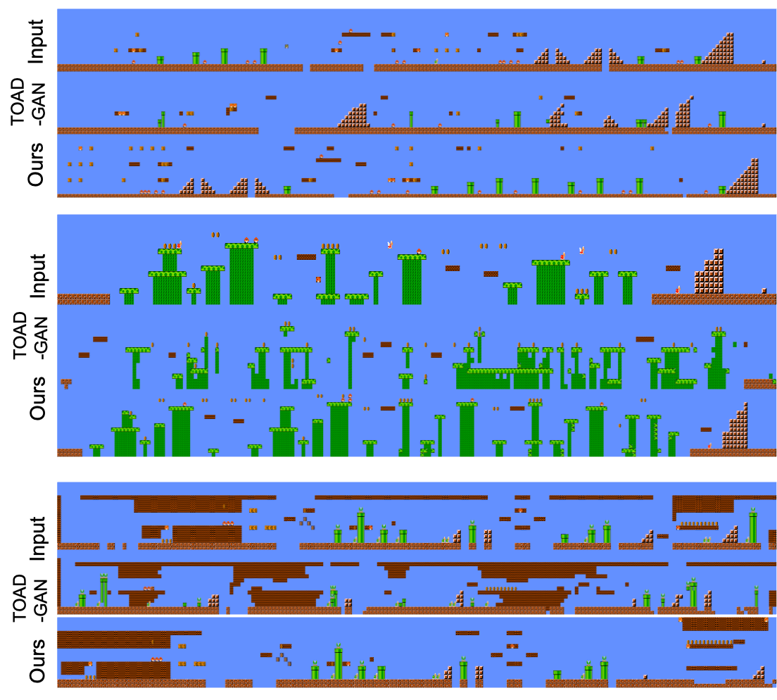
Experiments
Comparison with baselines - Super Mario Bros

Slide 18
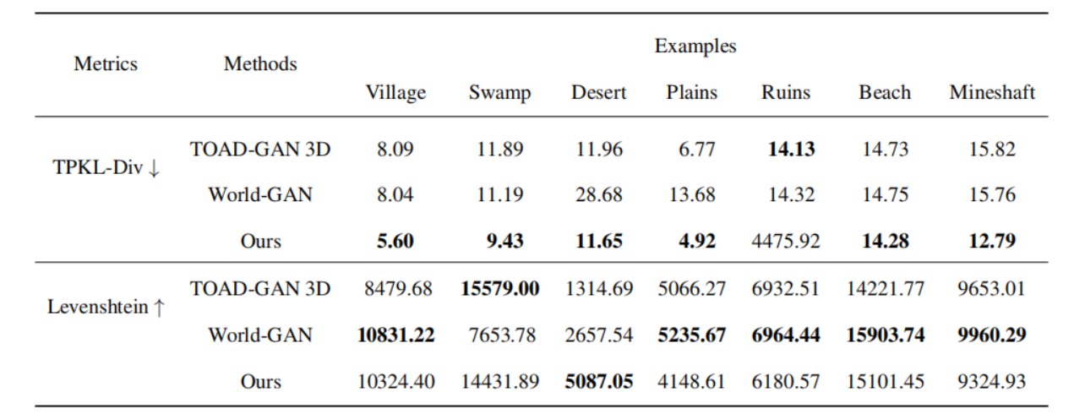
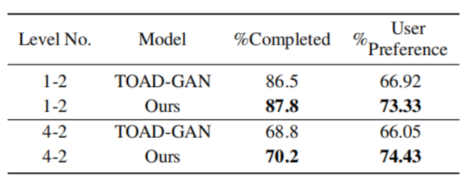
Experiments
Comparison with baselines
Tile Pattern KL-Divergence and Levenshtein Distance (Minecraft)
Level Playability and Human Preference Score (Super Mario Bros)
Our generated levels are more reasonable and have more details, while maintaining diversity at the same order of magnitude.

Slide 19
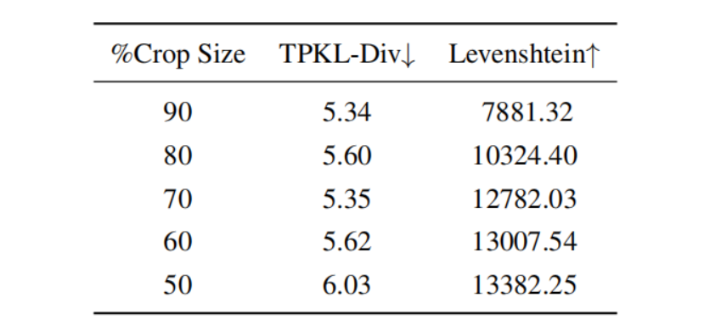
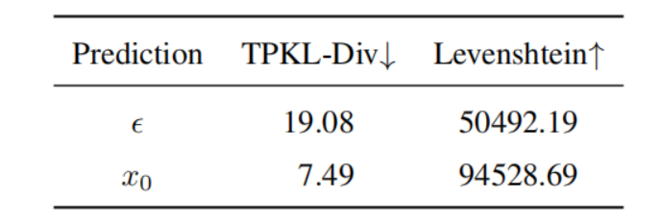
Experiments
Ablation Study
W/O Large Random Crop
Objective Parametrization
Generated outputs achieve enhanced visual
quality and diversity when a suitable crop size is employed.
Predicting $x_{0}$ is better in single example case.

Slide 20
Thank you!
Procedural Level Generation with Diffusion Models from a Single Example
Shiqi Dai, Xuanyu Zhu, Naiqi Li, Tao Dai, Zhi Wang*
mail: daisq21@mails.tsinghua.edu.cn
Notes:
\

